Slide 1
PROJECT REPORT - physics by aditya class xi-b roll no. 02

Slide 2
I would like to express my special thanks of gratitude to my teacher (Mrs.Vandana) as well as our principal who gave me the golden opportunity to do this wonderful project , which also helped me in doing a lot of Research and i came to know about so many new things I am really thankful to them. Secondly i would also like to thank my parents and friends who helped me a lot in finalizing this project within the limited time frame.
ACKNOWLEDGEMENT

Slide 3
Equipment used
1.Thermocol sheets
2.Flashlight
3.Magnifying glass
4.Transparent sheet
5.Scissor
6.Cutter
7.Marker

Slide 4
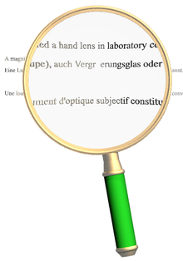
Magnifying glass
A magnifying glass (called a hand lens in laboratory contexts) is a convex lens that is used to produce a magnified image of an object. The lens is usually mounted in a frame with a handle (see image). A magnifying glass can be used to focus light, such as to concentrate the sun's radiation to create hot spot at the focus for fire starting.
A sheet magnifier consists of many very narrow concentric ring-shaped lenses, such that the combination acts as a single lens but is much thinner. This arrangement is known as a Fresnel lens.

Slide 5
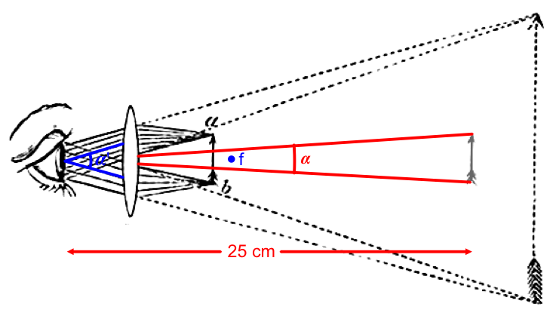
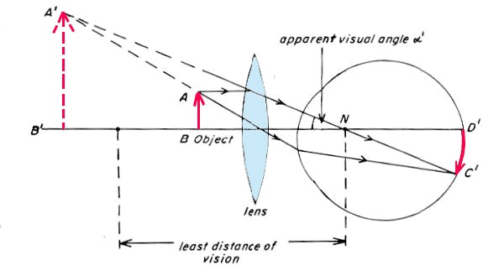
Working principle
A magnifying glass is actually
the simplest form of a basic
microscope. It consists of a
single convex lens that magnifies
an object when the glass is held
up to it. Historians believe a
scientist named Alhazen created
the first magnifying glass in 1021. Magnifying glasses make objects appear larger because their convex lenses (convex means curved outward) refract or bend light rays, so that they converge or come together. In essence, magnifying glasses trick your eyes into seeing something differently than it really is.
When light bounces off an object and travels to your eyes, those light rays travel parallel to each other. When they pass through a magnifying glass, the convex lens bends the parallel rays so that they converge and create a virtual image on your eyes' retinas.
That virtual image on your retinas appears larger than the real object due to principles of geometry. Despite the magnifying glass, your eyes trace the light rays back in parallel lines to the virtual image. Since the virtual image is farther from your eyes than the object is, the object appears bigger!
In addition to simple, handheld magnifying glasses, magnifying lenses play important roles as part of other devices, including binoculars, cameras, microscopes, and telescopes. Without the ability to magnify tiny objects, we wouldn't know much about tiny things like bacteria and viruses or far-away things, like stars and galaxies.

Slide 6
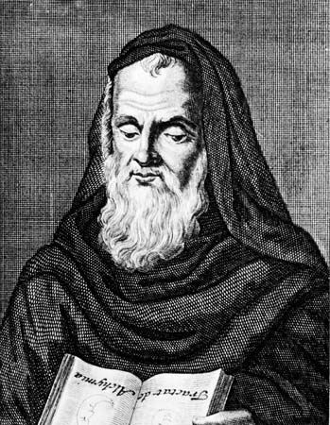
inventOR
Roger Bacon -
13-CENTURY ENGLAND
Roger Bacon was the inventor of the magnifying glass who described the properties of a magnifying glass in 13th-century England. Eyeglasses were developed in 13th-century Italy.

Slide 7
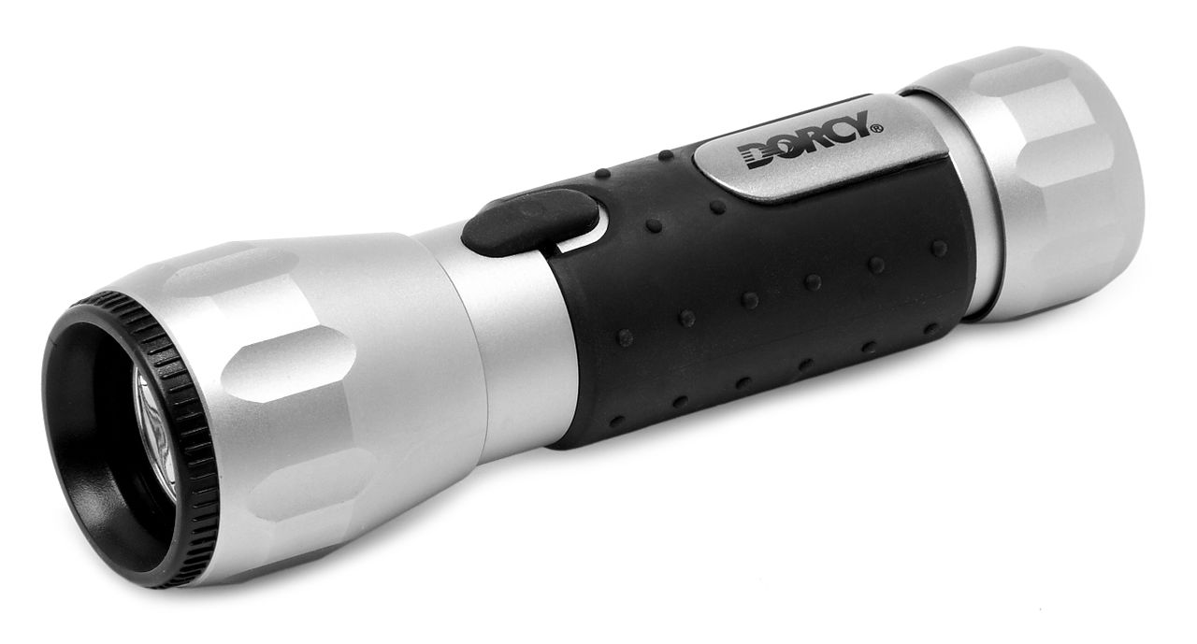
flashlight
A flashlight (more often called a torch outside North America) is a portable hand-held electric light. The source of the light is usually an incandescent light bulb (lamp) or light-emitting diode (LED). A typical flashlight consists of the light source mounted in a reflector, a transparent cover (sometimes combined with a lens) to protect the light source and reflector, a battery, and a switch. These are supported and protected by a case.
The invention of the dry cell and miniature incandescent electric lamps made the first battery-powered flashlights possible around 1899. Today, flashlights use mostly incandescent lamps or light-emitting diodes and run on disposable or rechargeable
batteries. Some are powered by the user turning a crank or shaking the lamp, and some have solar panels to recharge a battery.In addition to the general-purpose hand-held flashlight,
many forms have been adapted for special uses. Head or helmet-mounted flashlights designed for miners and campers leave the hands free. Some flashlights can be used underwater
or in flammable atmospheres. Flashlights are used as a light source when in a place with no power.

Slide 8
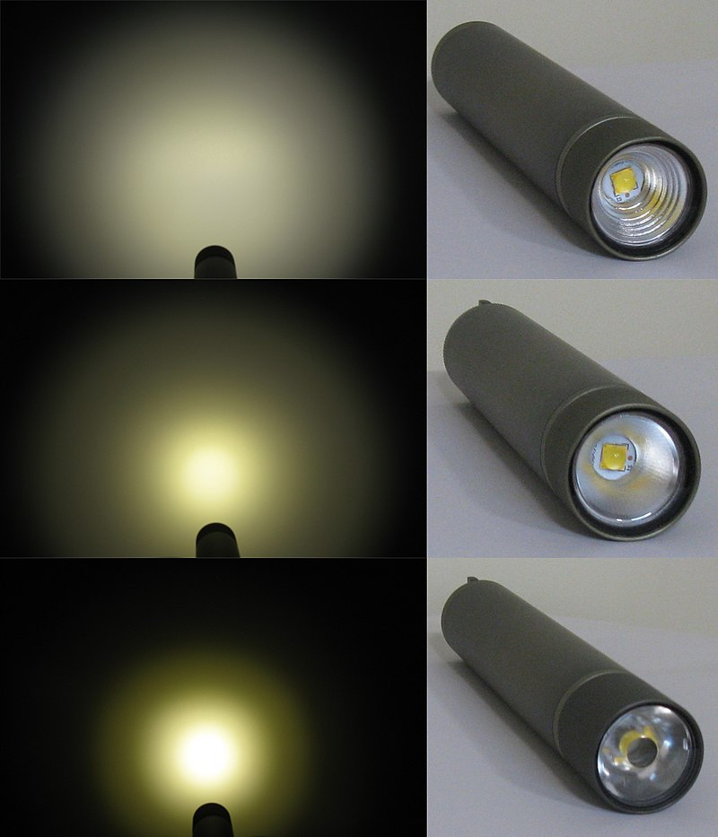
A reflector with an approximately parabolic shape concentrates the light emitted by the bulb into a directed beam. Some flashlights allow the user to adjust the relative position of the lamp and reflector, giving a variable-focus effect from a wide floodlight to a narrow beam. Reflectors may be made of polished metal, or glass or plastic with an aluminized reflective finish. Some manufacturers use a pebbled or "orange peel", instead of a smooth, reflector, to improve the uniformity of the light beam emitted. Where multiple LEDs are used, each one may be put in its own parabolic reflector. Flashlights using a "total internal reflection" assembly have a transparent optical element (light pipe) to guide light from the source into a beam; no reflector surface is required. For a given size of light source, a larger reflector or lens allows a tighter beam to be produced, while capturing the same fraction of the emitted light.
The reflector may have a flat transparent cover
to keep out dirt and moisture, but some designs
have a plastic or glass "bulls-eye" lens to form a
concentrated beam. The lens or reflector cover
must resist impacts and the heat of the lamp, and
must not lose too much of the transmitted light to
reflection or absorption. Very small flashlights may
not have a reflector or lens separate from the lamp.
Some types of penlight bulbs or small LEDs have a
built-in lens.

Slide 9
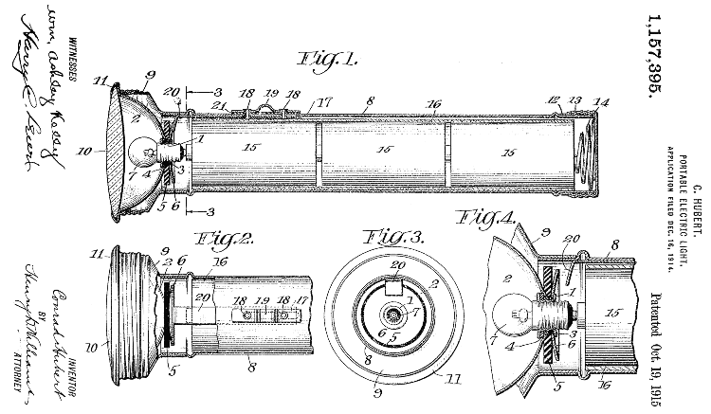
inventor
David Misell
It was a perfect power source for a portable light source. In 1899, English inventor David Misell invented the first flashlight. It had three D batteries placed in a tube that acted as a handle of the device. Batteries powered a small incandescent electric light bulb and a simple contact switch turned light on and off.

Slide 10
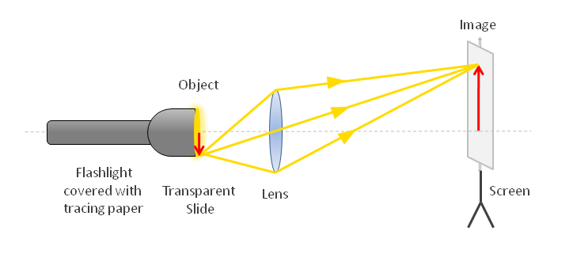
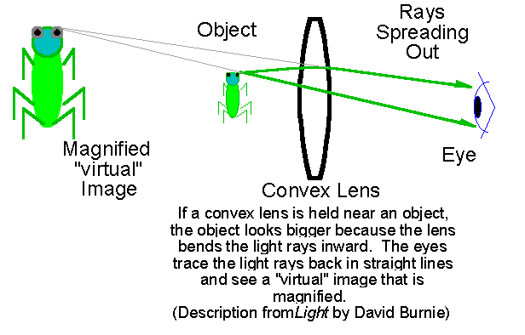

Slide 11
bibliography
Theory - NCERT
WIKIPEDIA
GOOGLE
Images - GOOGLE

